Slide 1
Class Project
Big data Architecture and Governance

Slide 2
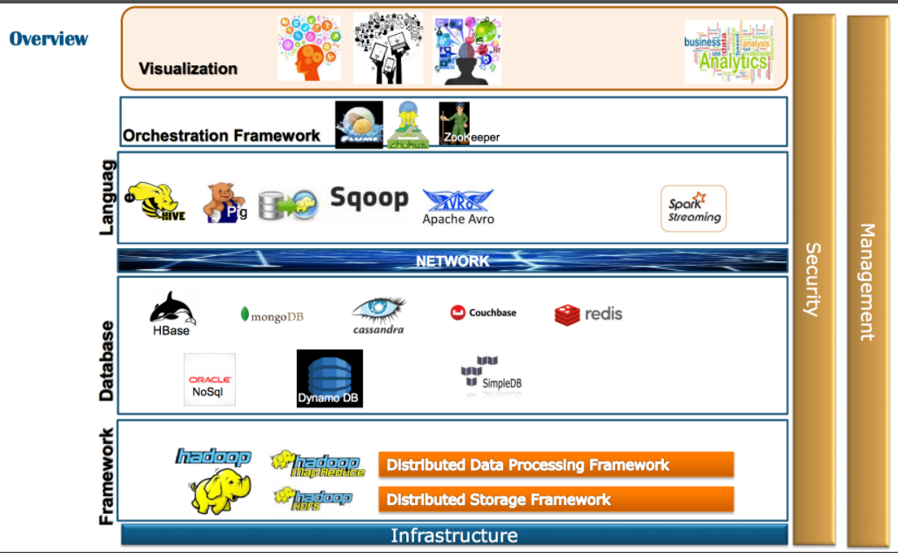
Overview

Slide 3
Languages
Avinash Yekkala
Colin Roddy
Ekta Chavan
Kinjal Gada
Neelesh Saxena

Slide 4
Languages and Orchestration
What comprises of the Languages and Orchestration layer?
Includes a workflow and provides a directed action towards larger goals and objectives
Composing of architecture, tools, and processes used by humans to deliver a defined Service

Slide 5
Selecting Orchestration tool:
So, before selecting the Orchestration for Big data project, first we analyze the needs of the organization.
First and foremost, we asked whether the organization need is Integration or machine learning or both, i.e.., analyzing the purpose.
Next, we asked what OS the organization is using.
Next, we asked what type of data the organization is dealing with.
Finally, we asked about the scalability ( scalability in our view is nothing but, the volume of data that organization is currently dealing with and expected growth of data in the near future).

Slide 6
Frameworks Under Consideration
Pentaho
Informatica
Talend
Skytree
Sqoop
Zookeeper
Flume
Nifi

Slide 7
Orchestration Frameworks
PAID
OPEN-SOURCE
Informatica, Pentaho, Talend, SkyTree
Zookeeper, Sqoop, Flume, Nifi
ETL with Analytics
ETL with Analytics
ETL w/o Analytics
Informatica, Pentaho, Talend, SkyTree
Nifi
Zookeeper, Sqoop, Flume

Slide 8
Attributes for Comparison of Frameworks
Purpose behind choosing the Framework
Prerequisites for each framework
How scalable is each of them
Level of Security
Cost involved in using each of the frameworks

Slide 9
Databases
Umang Chauhan
Chandni Sharma
Zineb Cherkani
Hanan Alsalamah
Ruiqi Zhang

Slide 10
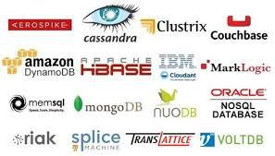
NoSQL Databases

Slide 11
NoSQL Databases Common Characteristics:
Storing large volumes of data that often have little to no structure.
Making the most of cloud computing and storage.
Rapid development.
Dynamic Schemas.
Horizontal Scalability.
High Performance.
Most NoSQL DB do not support ACID (Atomicity, Consistency, Isolation, Durability)

Slide 12
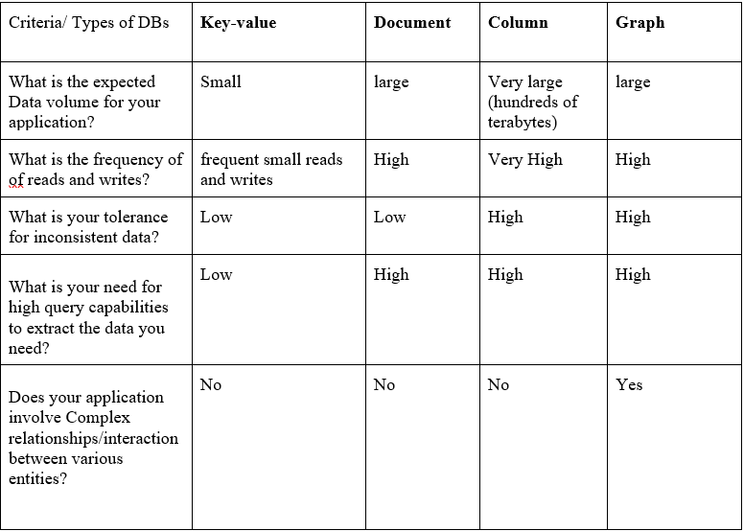
Types of NoSQL databases
There are 4 basic types of NoSQL databases:
Key-Value Store.
Document-based Store.
Column-based Store.
Graph-based.

Slide 13
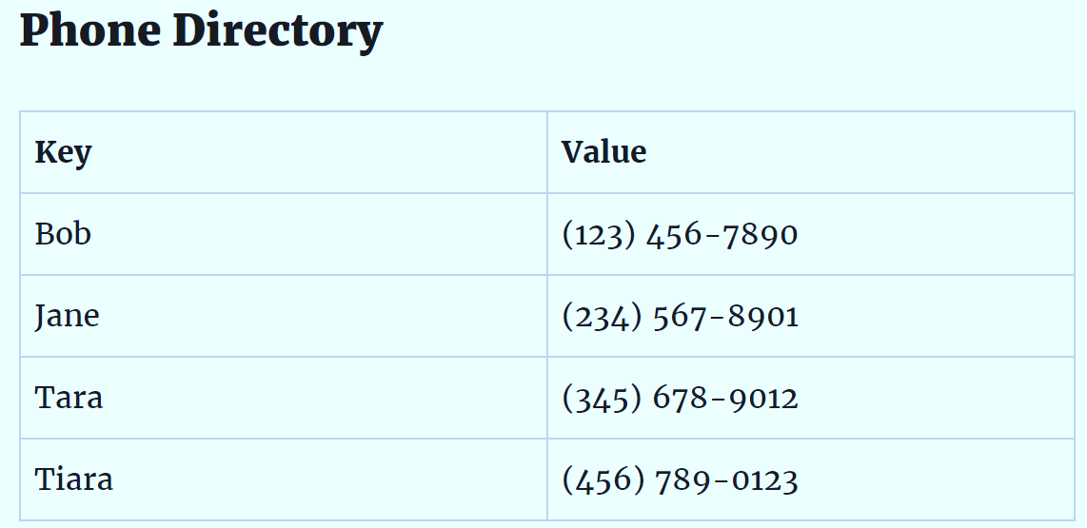
Key-Value Store Database
- Key-Value Store :
The least complex NoSQL option, which stores data in a schema-less way that consists of indexed keys and values.
The key value type uses a hash table in which there exists a unique key and a pointer to a particular item of data.
- Examples:
Redis, Oracle NoSQL and Amazon’s Dynamo are the most popular key-value store NoSQL databases.

Slide 14
What can a Key-Value Database be used for?
- General Web/Computers
User profiles
Session information
Article/blog comments
Emails
Status messages
- Ecommerce
Shopping cart contents
Product categories
Product details
Product reviews
- Networking/Data Maintenance
Telecom directories
Internet Protocol (IP) forwarding tables
Data deduplication

Slide 15
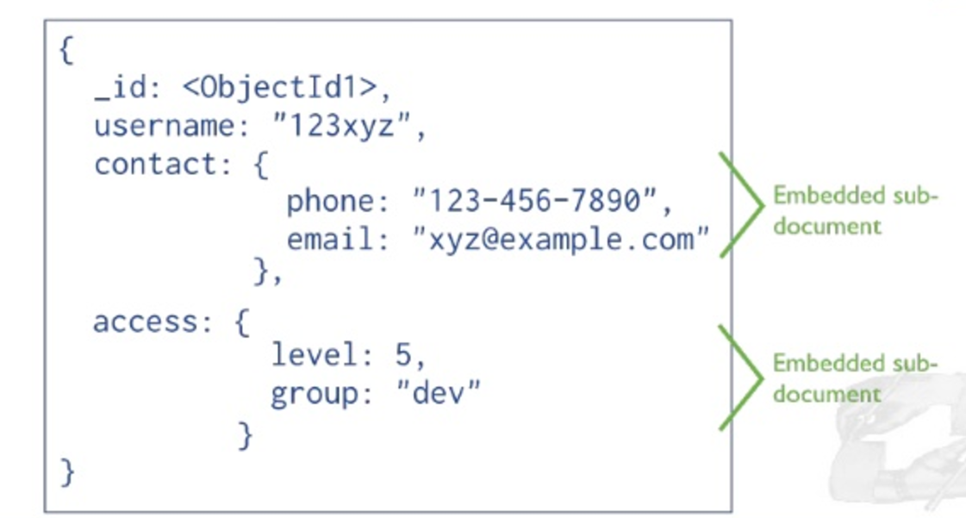
Document-based Store Database
- Document-based Store :
Taking the key-value concept and adding more complexity by storing documents (XML, JSON, BSON and so on) made up of collection of key value pairs.
- Examples:
MongoDB
DocumentDB
CouchDB
MarkLogic
OrientDB
Datastax
RethinkDB.
Terrastore

Slide 16
What can a Document Database be used for?
- Web Applications
Content management systems
Blogging platforms
eCommerce applications
Web analytics
User preferences data
- User Generated Content
Chat sessions
Tweets
Blog posts
Ratings
Comments
- Catalog Data
User accounts
Product catalogs
Device registries for Internet of Things
Bill of materials systems
- Gaming
In-game stats
Social media integration
High-score leaderboards
In-game chat messages
Player guild memberships
Challenges completed

Slide 17
Column-based Store Database
Column-based Store- is a type of database that stores data using a column oriented model.
- What can be used for?
Product Catalog/Playlist
Recommendation/Personalization Engine
Sensor Data/Internet of Things
Messaging
Fraud Detection
Examples: Cassandra, Hbase, Hypertable, Accumulo.

Slide 18
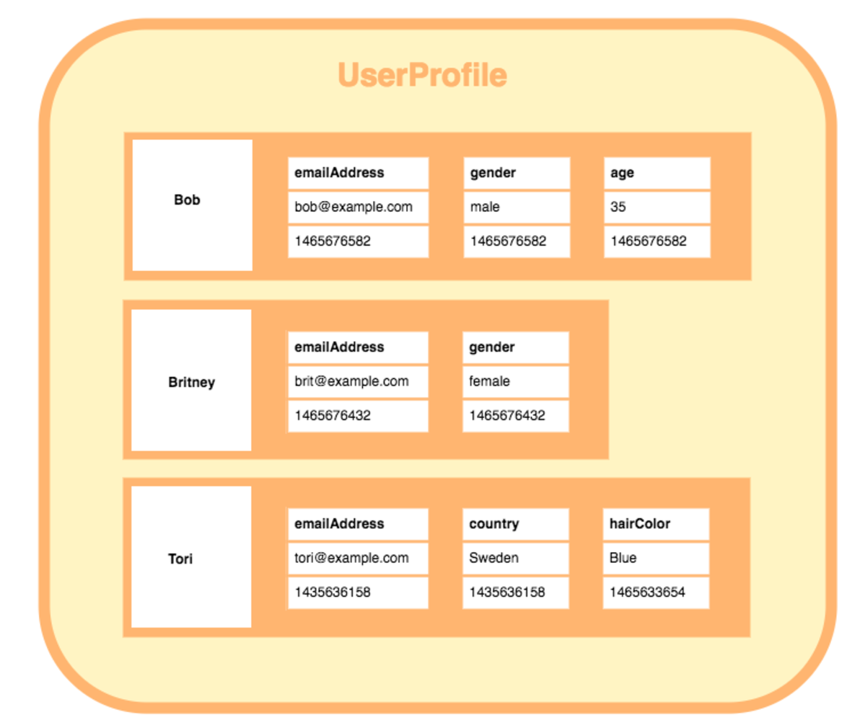
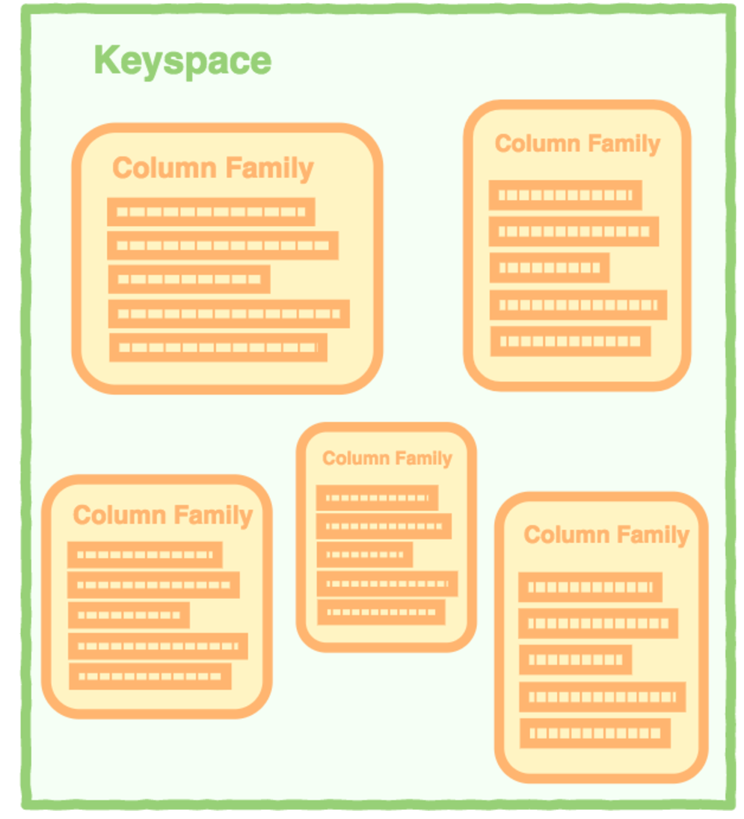
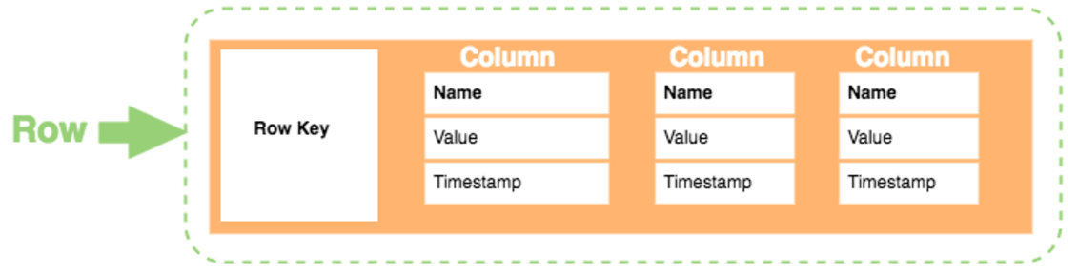
Column-based Store Database
Data Model:
Keyspace: This defines the outermost level of the application (database name).
Column Family: consists of multiple rows. Each row can contain:
Key: the permanent name of the record. Keys have different numbers of columns, so the database can scale in an irregular way.
Column: each row can have a different number of columns and the columns don’t have to match the columns in the other rows

Slide 19
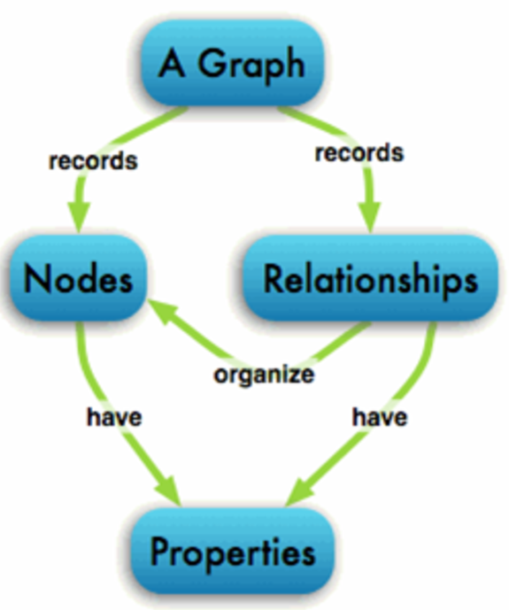
Graph-based Database
- Graph-based: a network database that uses edges and nodes to represent and store data.
These nodes are organized by some relationships with one another, which is represented by edges between the nodes.
Both the nodes and the relationships have some defined properties.
- What can be used for?
In general, the Graph DB is ideal for connected data require predictions, recommendations, and predictive analysis.
Examples:
OrientDB
Neo4j
DataStax
Scuba (Proprietary)by Facebook
FlockDB (Proprietary) by Twitter

Slide 20
NoSQL Databases Decision Making Process
1st Phase: Comparison Chart:
The Databases Comparison Chart has been developed to compare different features of all the databases.
No. of NoSQL Databases included: 22

Slide 21
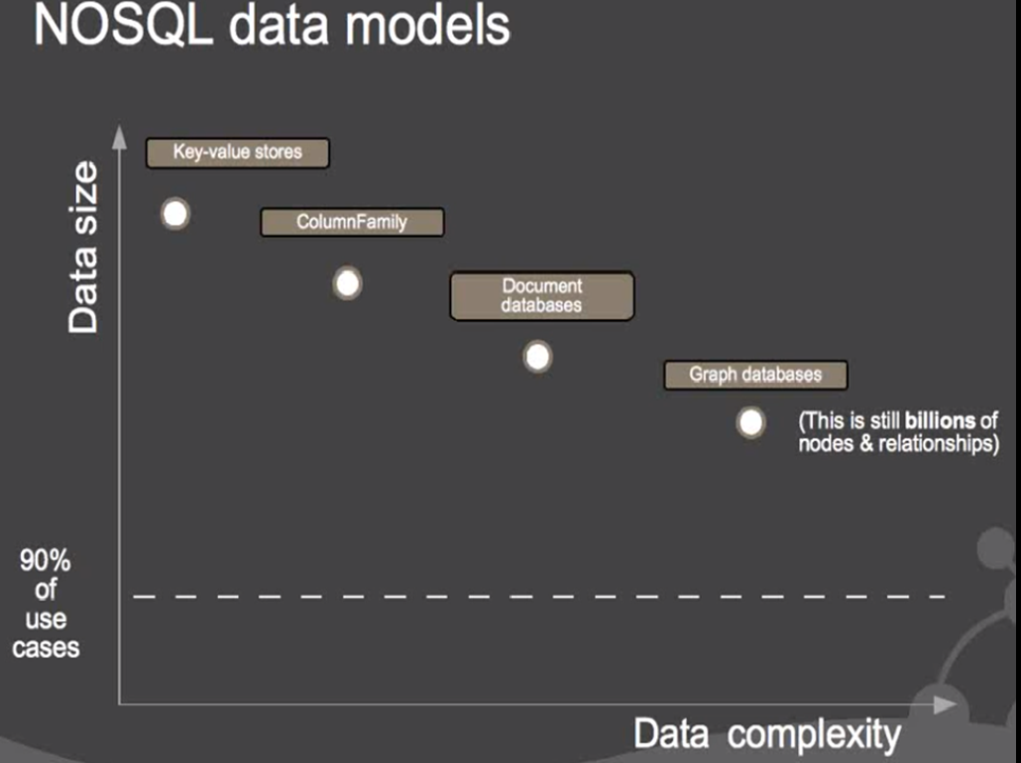
Selection Criteria

Slide 22
NoSQL Databases Decision Making Process
List of Comparison Features:
Category | License | Database Model | Data Storage | Query Language | Data Types
Map and Reduce | TTL (Time to Live) for entries | Integrity | Encryption | Transactions | Indexing (Composite keys and Geospatial Indexes)
Distribution (Horizontal scalable and Replication) | System Requirements (Operating System and Memory Requirements) | Implementation Programming Language | Real time Analytics | Cloud Platform Support | Web Interface
Full Text search | BI tool integration | Atomicity | Consistency | Isolation | Durability

Slide 23
NoSQL Databases Decision Making Process
2nd Phase: Develop List of Questions:
What is the frequency of reads and writes?
What is your tolerance for inconsistent data?
Does your application involve Complex relationships/interaction between various entities?
If your project demand different data model in addition to Complex relationships/interaction between entities, do you prefer one distributed system rather than having different vendors?
What is the need for high query capabilities to extract data?
What is the development platform?
What is the type of data that you will be using for your project?
Do you need real time analytics?
Do you want to use open source product?
Are you willing to consider/deploy on cloud options?
Do you need a web interface to operate and manage database?
Do you want to use database has APIs and other access methods?
What programming language does your application support?

Slide 24
Frameworks
Nikita Saple
Pratik Nellutla
Venkata Rishik Raavi
Himaja Vadega
Survi Singh

Slide 25
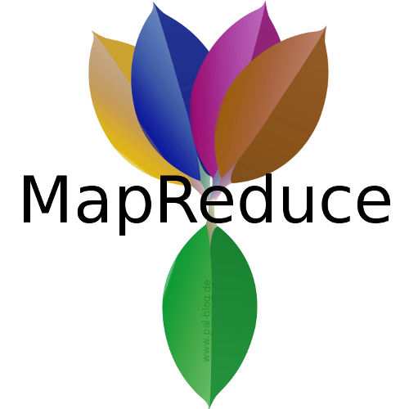




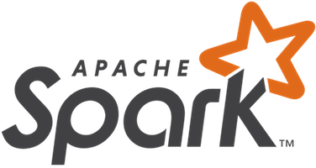
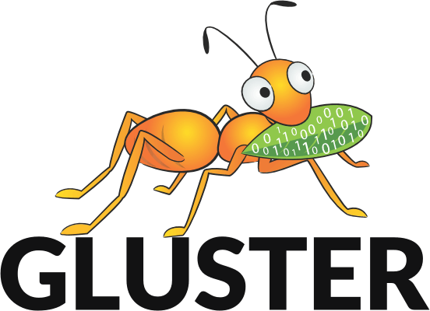
Frameworks

Slide 26
Framework Summary
Frame Work | Benefits | Pitfalls
Map-Reduce | Minimal data motion Simplicity Scalability Speed Recovery | Not suitable for Real Time Processing Uneasy to implement MapReduce Program High Latency
Hadoop | - Scalable - Cost effective - Flexible - Fast - Resilient to failure | - Not suitable for small data - potential stability issues (open source) - security concerns (missing encryption at storage and network level)
Storm | Fault tolerant, data guaranty, scalability | Duplicates may occur.
Spark | GraphX, Event Stream Processing, Run along Hadoop, Flexible | In-memory (Cost Efficiency),Garbage Collectors are not handled.

Slide 27
Framework Summary
Frame Work | Benefits | Pitfalls
Flink | Supports Hadoop and Storm with compatibility packages. web-based scheduling view to Java garbage collection Provides Real time processing. Provides a Hybrid of batch and real time streaming | Flink at the moment is still a very young project. There hasn't been much research into Flink's scaling limitations.
Peregrine | Scalability is achieved by partitioning. | - Not suitable for small data - potential stability issues (open source) - security concerns (missing encryption at storage and network level)
Gridgain | Advantage of any real-time business. Offering the most comprehensive, enterprise-grade in-memory computing solution. Helps anticipate and innovate ahead of market change | RAM is more expensive than disk storage.

Slide 28
Framework Summary
Frame Work | Benefits | Pitfalls
Gluster | no-metadata server architecture ensures better performance fault tolerant | LookUp calls sent to each node post its creation, rather than doing a multicast to all nodes
Avro | Schema evolution Untagged data Dynamic typing | C# Avro, need to use .NET 4.5 to make best use of it Potentially slower serialization. read/write data needs a schema
Tigion | Ability to handle extremely large data flows. pipelined query plans | The maximum number of Abstract Input Flow let instances is limited to one
Samza | Low Latency Same infrastructure for batch processing and streaming. | Low throughput

Slide 29
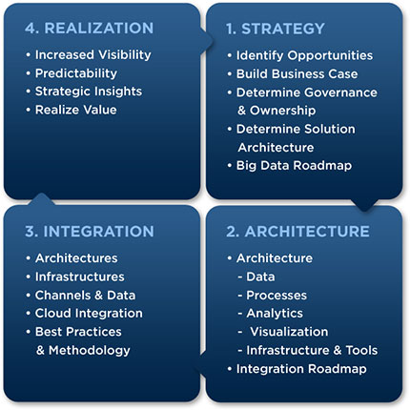
Big data analytics

Slide 30
Formation of Questions
Architecture
Security
BUSINESS SCENARIOS
Manageability
Language
Integration
Supported Platforms
Storage
Scalability

Slide 31
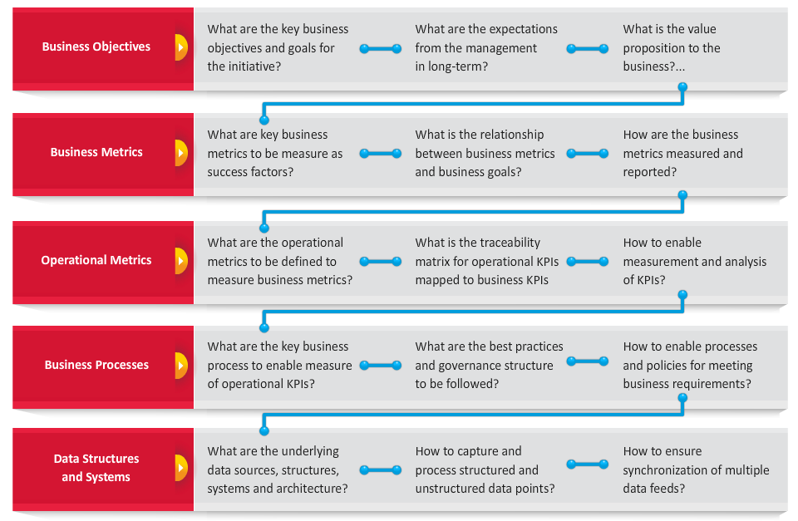
Modules addressed

Slide 32
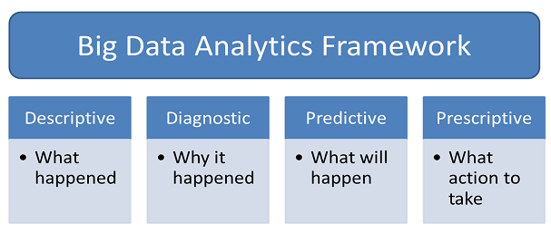
Quality Analytics

Slide 33
Proposed Timeline
Milestones
3/27: Group questionnaires finished
4/3: Group questions integrated into one questionnaire
4/10: Application Finished
4/17: Presentation ready
4/21: Presentation Day

Slide 34
Organization
Separation of work
Questionnaire
Application

Slide 35
Questionnaire
Three Main Groups
Languages/Orchestration
Framework
Database
Each group responsible for individual questionnaire
Final questionnaire built from these

Slide 36
Application
Application Team
Select application framework
Prototype application
Determine proper
Integrate final application
Questionnaire Team
Finalized questionnaire
Programmed questions

Slide 37
Wrap Up
Reshuffled groups from previous tasks
Presentation Team
Responsible for compiling presentation
Testing Team
Responsible for testing application

Slide 38
Application Deployment
https://survisingh65.github.io/

Slide 39
References:
https://www.3pillarglobal.com/insights/exploring-the-different-types-of-nosql-databases
http://database.guide/what-is-a-key-value-database/
http://database.guide/what-is-a-document-store-database/
https://www.upwork.com/hiring/data/sql-vs-nosql-databases-whats-the-difference/

